Slide 1
Illinois Board of Higher Education Update
Illinois Association of Colleges of Teacher Education Fall Conference Normal, Illinois November 9, 2018
Sophia Gehlhausen Anderson, M.S. Assistant Director for Academic Affairs Illinois Board of Higher Education

Slide 2
Greetings from Stephanie Bernoteit!

Slide 3
Overview of Presentation
College completion in Illinois
Transfer success in Illinois
Reverse transfer
Outmigration from Illinois
Legislative actions
Dual Credit/Dual Enrollment
Election results

Slide 4
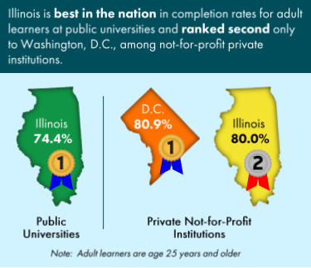
Illinois Proud: College Completion for Adult Learners
Adult learners are defined as age 25 and older
Completion was counted regardless of how many institutions a student attended
Graph includes full-time and part-time students
Source: Shapiro, D., Dundar, A., Huie, F., Wakhungu, P., Yuan, X., Nathan, A., & Bhimdiwala, A. (2018, February). Completing College: A State-Level View of Student Completion Rates (Signature Report No. 14a.). Herndon, VA: National Student Clearinghouse Research Center.
Notes:
Data for this and the following 3 slides came from a report released in 2018 by the National Student Clearinghouse.
National Student Clearinghouse is a secure repository for various datasets including financial aid, enrollment, and completion data.

Slide 5
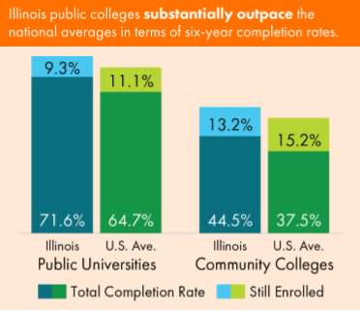
Illinois Proud: Six-Year Completion Rates
Graph includes students of all ages, full- & part-time
Both Illinois public universities and community colleges outpace the national averages
Students may have attended >1 institution in the six-year period
Completion counted at final institution

Slide 6
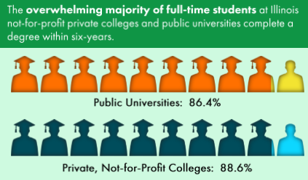
Illinois Proud: Public and Private IHE
Graph includes full-time students only
All ages included
At both public and private universities and colleges, a large majority of students complete a bachelor’s degree

Slide 7
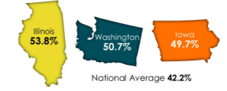
Transfer Success in Illinois
Source: IBHE DataPoints 2018-9
Notes:
Student cohort entered a community college in 2010
Illinois leads the nation in bachelor’s degree completion rates among community college students who transfer to four-year colleges.
Our average is 11.6 percentage points higher than the national average.
Relative to other national leaders, IL serves significantly more community college transfer students, IHEs, and transfer-in students.
Note that full-time and part-time students were included in the cohort which suppressed the completion rate.
Note also that students who enrolled in dual-credit or dual-enrollment courses were not included which also suppressed the completion rate.
These two facts make the results even more impressive.
Transfer success in IL is a result of two complementary statewide transfer tools: IAI and MyCreditsTransfer.

Slide 8
Transfer Success in Illinois - IAI
Illinois Articulation Initiative
In existence since 1993
Statewide transfer agreement including 113 participating IHEs, both public and private
Over 55,000 students transfer to/from IL institutions each fall
Participating schools accept a general education course “package” in lieu of their own gened requirements
Also includes course recommendations for the first two years of college in several popular majors developed by faculty in the respective fields of study
Individual courses are also transferable
itransfer.org/

Slide 9
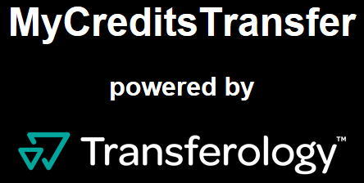
Transfer Success in Illinois - MyCreditsTransfer
MyCreditsTransfer
In existence since 2014
Statewide initiative designed to facilitate transfer within IL (or outside the state or country) using a national tool, TransferologyTM
Students maximize transfer potential by entering courses into the portal and learning how much credit they would receive at different institutions
Students can also explore value of alternative types of credit like standardized exams, and military and international courses
mycreditstransfer.org/

Slide 10
Reverse Transfer
Amendment to Senate Bill 2354 passed June 2018
Defines “reverse transfer of credit” as “the transfer of earned academic credit from a State university to a community college for the purpose of obtaining an associate degree at the community college.”
Mandates IBHE and ICCB to develop a policy to foster reverse transfer of credit.
Facilitated by the National Student Clearinghouse® to make transferring possible within and between states and reduce the administrative load on institutions.
66 percent of students transfer before earning an associate’s degree.

Slide 11
Reverse Transfer – Benefits to Students
Gives a feeling of accomplishment and provides positive momentum towards a bachelor’s degree (in one sample, 84% of students who earned an associate’s degree completed their bachelor’s degree¹)
Increases student income while in college and lifetime earnings (studies show completing an associate’s degree yields approximately $4,640-$7,160 per annum in extra earnings²)
Targets student population with highest student loan default rates and makes repayment more attainable³
¹ Boren, R. et al. (2014). Reverse Transfer and Degree Awarding Agreements to Help Transfers Earn Their Associate’s at a Four Year School.
² Belfield, C & Bailey, T. (2017). The Labor Market Returns to Sub-baccalaureate College: A Review. Center for Analysis of Postsecondary Education and Employment.
³ Federal Reserve Bank of New York Consumer Credit Panel and Equifax. Published in TheUpshot, NYT, August 31, 2015.

Slide 12
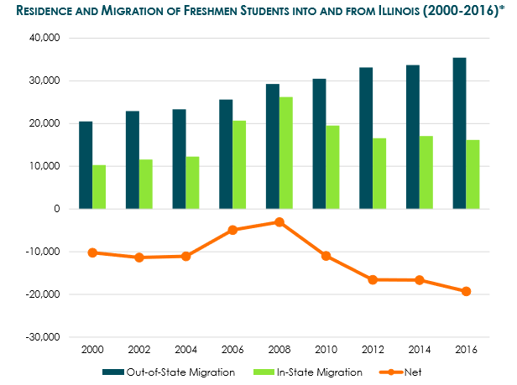
Outmigration of Freshmen Students from Illinois
Outmigration has been happening for decades but in-state migration offset it for years
Majority of out-of-state students in IL are international, in addition to CA, IN, MO, MI, NJ, & WI
Note that decrease in orange line signifies an increase in outmigration
Source: IBHE DataPoints 2018-1
Notes:
Relative to 2014, the number of IL residents enrolled outside the state has increased by 5%
In 2016, the net loss of IL residents to colleges in other states was -19,278
Relative to 2000, outmigration has increased by 73%

Slide 13
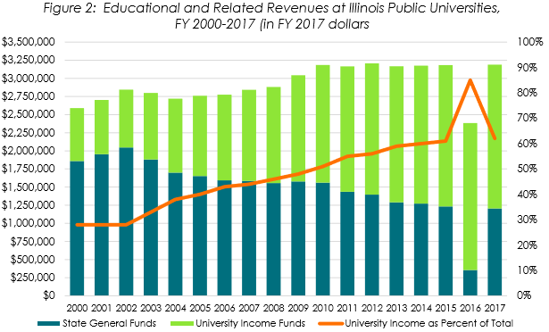
Outmigration: Product of Reduced State Support for HE
Decrease in state appropriations forces IHEs to depend more on tuition income
Weighted tuition increased by 40.9% from 2010 to 2017, or about 5.8% per year
This more than 3X the increase in CPI over the same time period
Neighboring states capitalize on this and lure students out of state.
Source: IBHE DataPoints 2018-8

Slide 14
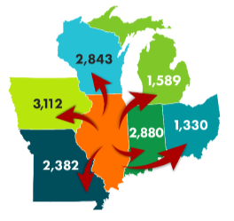
Outmigration: Where Are They Going?
Majority of students migrate to neighboring states in the Midwest
Most outmigrants attend out-of-state public universities
Enrollment at out-of-state private colleges decreased slightly from 2014-2016
Source: IBHE DataPoints 2018-2

Slide 15
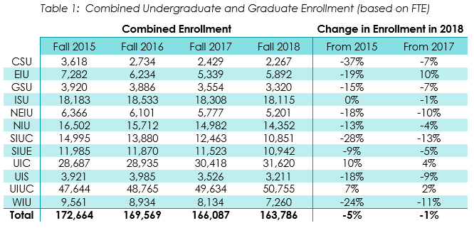
Good News: Enrollment in IL Public IHEs Has Increased
Decline in enrollment decreased when comparing 2015-2018 and 2017-2018
Large variation in enrollment changes among public universities
Most of decline was in undergraduate population (6% and 2%)
Grad student population remained stable
Source: IBHE DataPoints 2018-10

Slide 16
Legislative Actions Aimed at Keeping Students in Illinois
Public Act 100-0823 – amends the Higher Education Student Assistance Act requiring ISAC to establish a priority deadline annually for renewing MAP applicants.
Public Act 100-1015 – creates the AIM HIGH Grant Pilot Program and appropriates $25 million for FY19.
Public Act 100-824 – mandates IBHE and ICCB to develop a policy to foster reverse transfer of credit for any student with at least 15 hours of academic credit at a CC.
Public Act 100-1007 – establishes the College and Career Interest Task Force to facilitate the sharing of college or career interest data of HS students among public IHE.
Notes:
100-0823 – if students make the deadline AND continue to meet the program’s eligibility requirements, they are guaranteed a MAP grant
100-1015 – public universities can apply to ISAC for grant funds and must match the amount they receive with an equal amount of institutional funding
100-824 Aimed at increasing students who reverse transfer credits to obtain associate’s degrees
100-1007 Aimed at helping to match HS students with programs in their areas of interest

Slide 17
Dual Credit/Dual Enrollment
Public Act 100-1049 – Amends the Dual Credit Quality Act
Dual credit increases chances of degree completion
Expanding nationwide (in CO, a leader in DC implementation, 1 in 3 students participate), but students of color and low-income students lag behind in participation rates
Courses should be transferable and serve a clear purpose
IBHE, ISBE, and ICCB working together to create a teacher endorsement option to indicate when instructors are qualified and for what courses
Will follow the course coding used with IAI to ensure clarity and transferability
Notes:
Provisions include, but not limited to, mandate for CCs, right of first refusal for CCs, faculty qualifications, professional development, etc.

Slide 18
Election Results and Higher Education
Federal Level
State Level
Higher Education Act: PROSPER vs. Aim Higher
Gainful employment,
Borrower-defense rule, and
Public Service Loan Forgiveness
Governor will fill four Board members with terms expiring in January 2019, and possibly three more that were never confirmed by the Senate.
Possibly increased interest in/involvement by Governor’s office on IBHE initiatives.
Statutory responsibilities will not change
Notes:
Under Secretary DeVos, DoE has taken step to weaken consumer protection laws enacted by Obama’s administration, including potential elimination of:
--Gainful employment rules increase accountability for for-profit IHE by tying federal student aid dollars to student employment outcomes.
--Borrower-defense rule allowed students to apply for federal student loan forgiveness in cases where they claim institutions misled them about the quality of their programs and their potential employability as graduates. (e.g. Corinthian, ITT Tech, Adtalem/DeVry).
--Public Service Loan Forgiveness allows individuals employed in the public or nonprofit sector to apply for loan forgiveness after ten years of making payments on their loans. However, many applications have been denied due to confusion about eligibility resulting from unclear wording of the statute.
One possible version of a new HEA, the PROSPER act, would do just that.
However, Democrats are likely to propose a version of the HEA like Aim Higher which would strengthen and expand those provisions.
Maybe establishment of other task forces like the Behavioral Health and College and Career Interest Task Forces.
Statutory Responsibilities include, for example, budget compilation, program and institution approvals, maintenance of information system, and several reports to the GA (underrepresented groups, new, closed and underperformin programs).

Slide 19
Discussion/Q & A
For Further Information
Sophia Gehlhausen Anderson, M.S.
Gehlhausen@ibhe.org

