Slide 1
IACTE Fall Conference
November 9, 2018
Alumni Hall

Slide 2
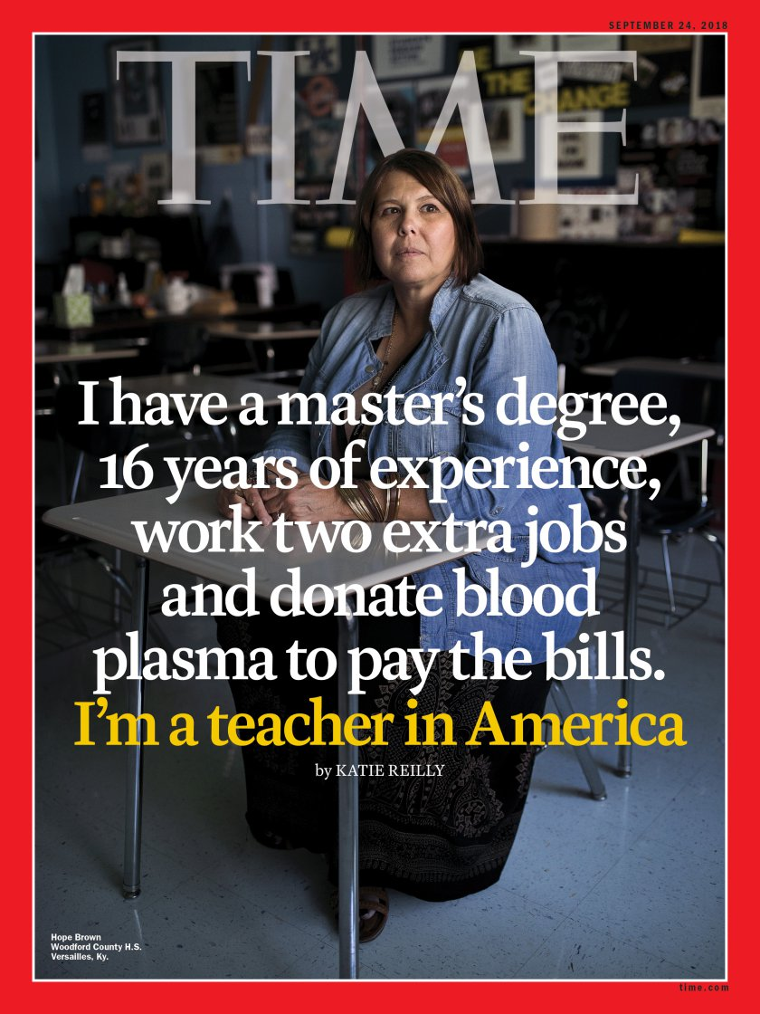
9/24/18

Slide 4
The Changing Landscape of Educator Preparation: The Essential Roles of Colleges of Education

Slide 5
AGENDA -- Morning
Deb Koolbeck and Todd Price
The National Terrain
MJS and Associates
The State View
Jason Helfer
ISBE Update
Lunch with Sanford Inspire

Slide 6
AGENDA -- Afternoon
IACTE Business Meeting
IBHE Update
Sophia Gehlhausen Anderson
So what?
Working together to identify next steps
Wrap-up and Adjournment

Slide 7
Deb Koolbeck
Senior Director, Government Relations
AACTE
Todd Price
Government Relations Liaison

Slide 8
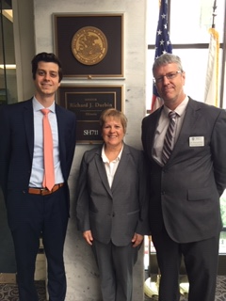
Todd’s influence in DC

Slide 9
MJS Associates

Slide 11
Jason Helfer
Deputy Superintendent
Center for Teaching and Learning
ISBE

Slide 13
Sanford Inspire Presentation

Slide 14
IACTE Business Meeting
Approval of reports
Treasurer – Kelly Brown
Secretary – Tracy Spesia
Licensure – Brenda Clevenger, Gretchen Fricke
Government Relations – Kathy Taylor, Christy Borders
Spring Meeting and Day at the Statehouse – April 8-9, 2019
Legislative Network
Adjournment

Slide 15
Illinois Board of Higher Education
Sophia Gehlhausen Anderson
Assistant Director for Academic Affairs

Slide 16
So what?

Slide 17
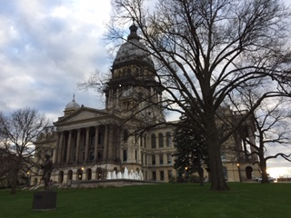
Wrap-up
Spring Conference
And
Day at the Statehouse
April 9-10, 2019
Springfield

