Slide 1
IACTE
October 14, 2016

Slide 2
Overview
OOS Test of Basic Skills
APR vs CAEP
PEP
Standards
Fast Track Document
Grade Bands
Administrative Code
Entitlements
Tables
UPDATES
MIDDLE GRADES

Slide 3
UPDATES

Slide 4
OOS Test of Basic Skills
Institutions may honor OOS Test of Basic Skills if the test is listed in the “Testing” sections of a candidates ELIS account.
Candidate
Licensure Officer
80-02 State-Approved Program and Completion of Standards Verification
OR
80-03 Out-of-State Test of Basic Skills Verification: Department/Board of Education Use Only.
Ensure 80-02/80-03 is listed as image in Candidates ELIS account
Email ISBE liaison to review test
If OOS test of basic skills is accepted ISBE liaison will enter the OOS test of basic skills in the testing section of the educator’s ELIS account.

Slide 5
APR vs CAEP
State annual program report due November 30, 2016 for all institutions
State agreement not yet finalized
New elements relating to PEP work

Slide 6
PEP
Pilot Applications
Timelines
November 2016-February 2017: Data Collection
March 1- Data submitted to ISBE
July 1- Reports created by ISBE for each institution and its programs
Goals
Determine what indicators need revised or omitted based on ability to inform program improvement and provide actionable data;
Identify and solve data collection barriers;
Receive ISBE support as you ; and
Provide ISBE feedback before system is finalized

Slide 7
Standards
ESL/Bilingual (27.145)
Early Childhood Education (26.110(d))
No later than September 1, 2018, all approved teacher preparation programs that offer coursework and clinical experiences leading to the receipt of an ESL/bilingual education endorsement shall submit the course of study for ESL and/or bilingual education with evidence that the program's or course's content is congruent with the standards identified in this Section. An application for approval of a new preparation program or course of study submitted on or after September 1, 2018 shall provide evidence of congruence with the standards identified in this Section.
Endorsement Matrix
Gateways to Opportunity Credential Entitlement
By no later than September 1, 2019, each early childhood education program shall become entitled by the Gateways to Opportunity Illinois Professional Development System, by aligning its coursework to the benchmarks for the ECE Credential Level 5 (see http://www.ilgateways.com/en/gateways-credentialentitlementinformation).
1) Satisfactory evidence of entitlement status either shall be the name of the program's recognized institution listed at http://www.ilgateways.com/en/entitled-institutions or a letter communicating the name and level of the credential of entitlement and the date upon which the entitlement was granted.
2) The program shall resubmit the evidence required under subsection (d)(1) to the State Superintendent of Education each time a renewal of entitlement is granted.

Slide 8
MIDDLE GRADES
An Overview of the new Middle Grades licensure and endorsement requirements

Slide 9
Middle Grades (5-8) Fast Track Program Proposal

Slide 10
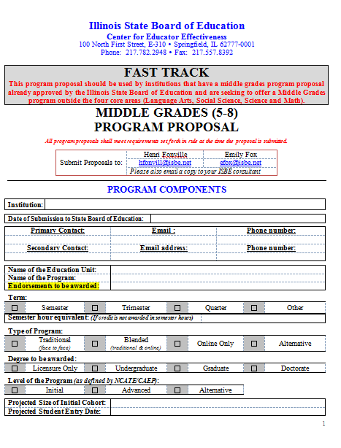
Fast Track Middle Grades (5-8) Program Proposal
Friday, October 7, 2016 SEPLB approved the MG Fast Track Proposal
This program proposal should be used by institutions that have a middle grades program proposal already approved by the Illinois State Board of Education and are seeking to offer a Middle Grades program outside the four core areas (Language Arts, Social Science, Science and Math).
For SEPLB approval, the “Fast Track” program proposal must be submitted with the Middle Grades Program Proposal that was originally approved, including any appendices.
Please note for institutions submitting “New” Middle Grades Programs, this Fast Track proposal does not need to be completed in addition to the Middle Grades proposal. There is an area on the Middle Grades Proposal for institutions to indicate coursework in areas outside the four core areas.

Slide 11
Evolution of the Grade Band
Endorsements through the years

Slide 12
“Junior High” Endorsements
Until June 30, 1997
Junior high endorsements were issued until June 30, 1997, and could be attained by completing content-specific coursework. The endorsements allowed educators to teach specific content areas in grades 5-8 and 6-8.

Slide 13
“Middle School” Endorsements
On or After July 1, 1997-Until January 31, 2018
Middle school endorsements have been issued since July 1, 1997, and will continue to be issued until January 31, 2018. Middle school endorsements differ from the previous junior high endorsements because they require of six additional semester hours of Middle School professional education coursework, including:
3 semester hours of coursework in middle school philosophy, curriculum, and instruction methods for designing and teaching developmentally appropriate programs in middle grades, including content area reading instruction; and
3 semester hours of coursework in educational psychology focusing on the developmental characteristics of early adolescents and the role of the middle grade teacher in assessment, coordination, and referral of students to health and social services.
These endorsements allow educators to teach specific content areas in grades 5-8 and 6-8.

Slide 14
“Middle Grades” Endorsements
On or After February 1, 2018
Middle Grades endorsements are currently being issued to educators who complete an Illinois approved middle grades program.
Beginning February 1, 2018:
All “New” middle grades endorsements will be earned by completing an Illinois approved middle grades program; and
All “Subsequent” middle grades endorsements will be earned by completing 21 semester hours of content-specific coursework, 3 semester hours of content-specific methodology coursework focused on the middle grades, and passing the applicable content test(s).
Also, beginning February 1, 2018, middle grades endorsements will be available to educators prepared as middle grades educators at out-of-state institutions.
These endorsements allow educators to teach specific content areas in grades 5-8.

Slide 15
23 Illinois Administrative Code

Slide 16
23 Illinois Administrative Code
Information regarding the requirements for middle grades endorsements can be found in the following sections of administrative code:
• 23 Illinois Administrative Code, Part 1, Section 1.720 (Public Schools evaluation, recognition and supervision-Requirements for Teachers of Middle Grades)
• 23 Illinois Administrative Code, Part 21, Section 21.10 & 21.100-21.150 (Standards for endorsements in the Middle Grades)
• 23 Illinois Administrative Code, Part 25, Section 25.99 (Educator Licensure-Endorsements for the Middle Grades(Grades 5 through 8)

Slide 17
Entitlements

Slide 18
Entitlement
Until January 31, 2018
Currently, all Illinois institutions of higher education may enter entitlements for middle school endorsements. No approved program is required. Institutions can continue this practice until January 31, 2018.
On or after February 1, 2018,
Only Illinois institutions of higher education that offer Illinois approved middle grades (5-8) programs may entitle educators for new middle grades endorsements.
Institutions able to enter entitlements for subsequent middle grades (5-8) endorsements are not limited only to those institutions that have approved middle grades programs. Such a limitation could burden educators who are unable to complete coursework at an institution offering an approved program due to geographic location, course scheduling or other factors.
Likewise, coursework for all subsequent middle grades (5-8) endorsements may be taken at any Illinois or out-of-state institution of higher education that is regionally accredited.
At their discretion, institutions of higher education offering approved middle grades (5-8) programs may accept coursework taken at other institutions as credit toward program completion.

Slide 19
Middle Grades Requirements Tables

Slide 20
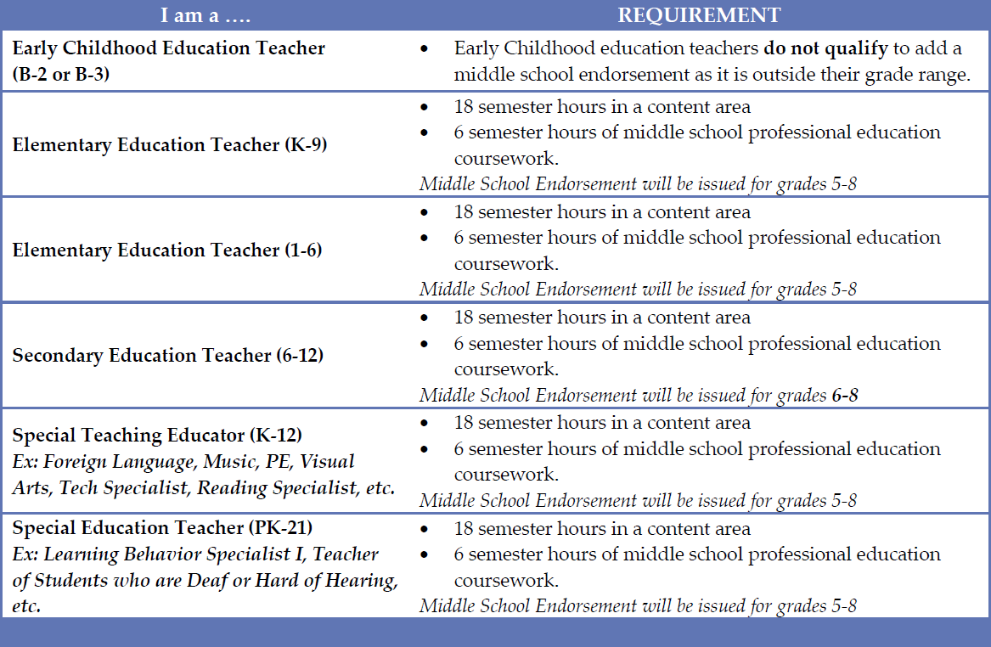
Requirements for educators seeking new or subsequent Middle School endorsements prior to February 1, 2018.

Slide 21
Requirements for educators seeking new or subsequent Middle School endorsements prior to February 1, 2018.
Until January 31, 2018, educators may request institutions of higher education enter the endorsement into their ELIS account through the entitlement process.
Educator would have one year to apply for the entitlement.
Or, until 11:59 pm CST on January 31, 2018, educators may apply for a middle school endorsement in their ELIS accounts and undergo transcript evaluation through ISBE.
Educators would have two full fiscal years to satisfy any deficiencies identified during ISBE transcript evaluation.

Slide 22
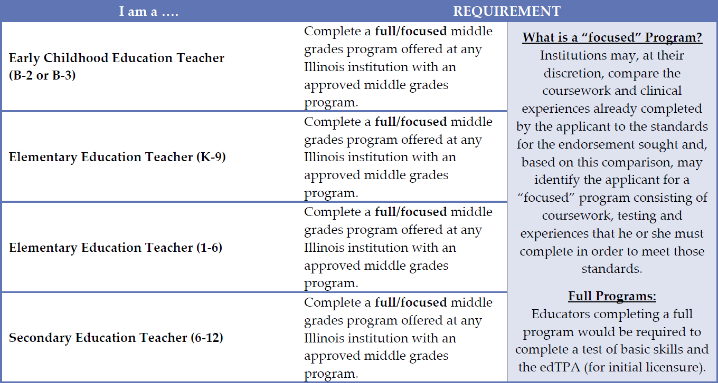
Requirements for Educators seeking a new Middle Grades (5-8) endorsement on or after February 1, 2018

Slide 23
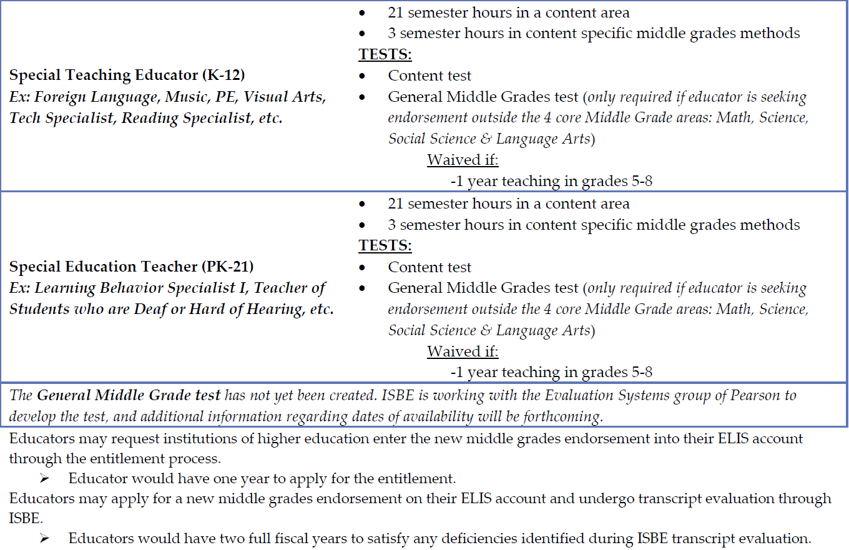
Requirements for Educators seeking a new Middle Grades (5-8) endorsement on or after February 1, 2018
The General Middle Grades test is anticipated to be available early spring, 2018. Until it is available, educators required to take the General Middle Grades test would take the Elementary/Middle grades 110 test.
The content test is those content area tests already available
(Most notably taken by our secondary candidates and educators).

Slide 24
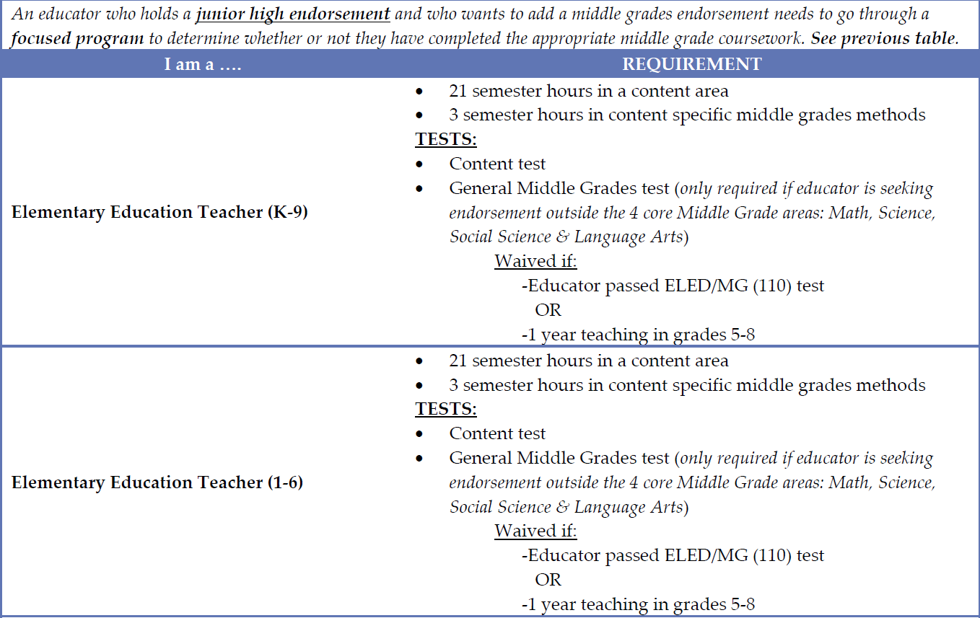
Requirements for educators seeking subsequent Middle Grades (5-8) endorsements on or after February 1, 2018

Slide 25
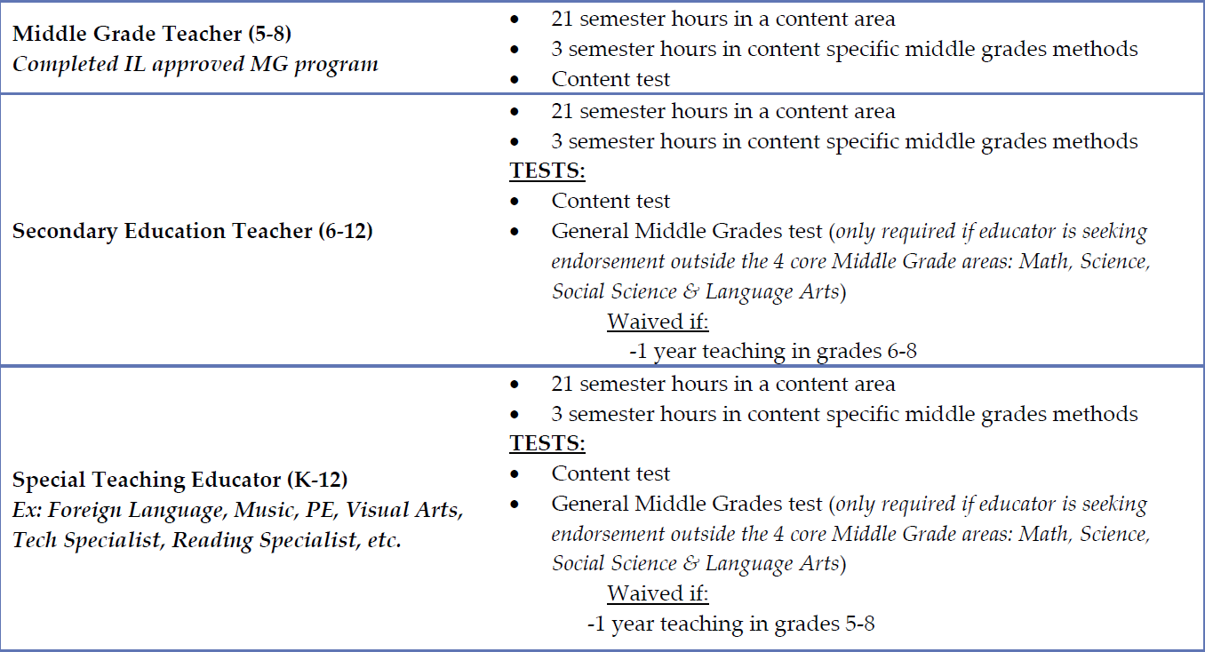
Requirements for educators seeking subsequent Middle Grades (5-8) endorsements on or after February 1, 2018

Slide 26
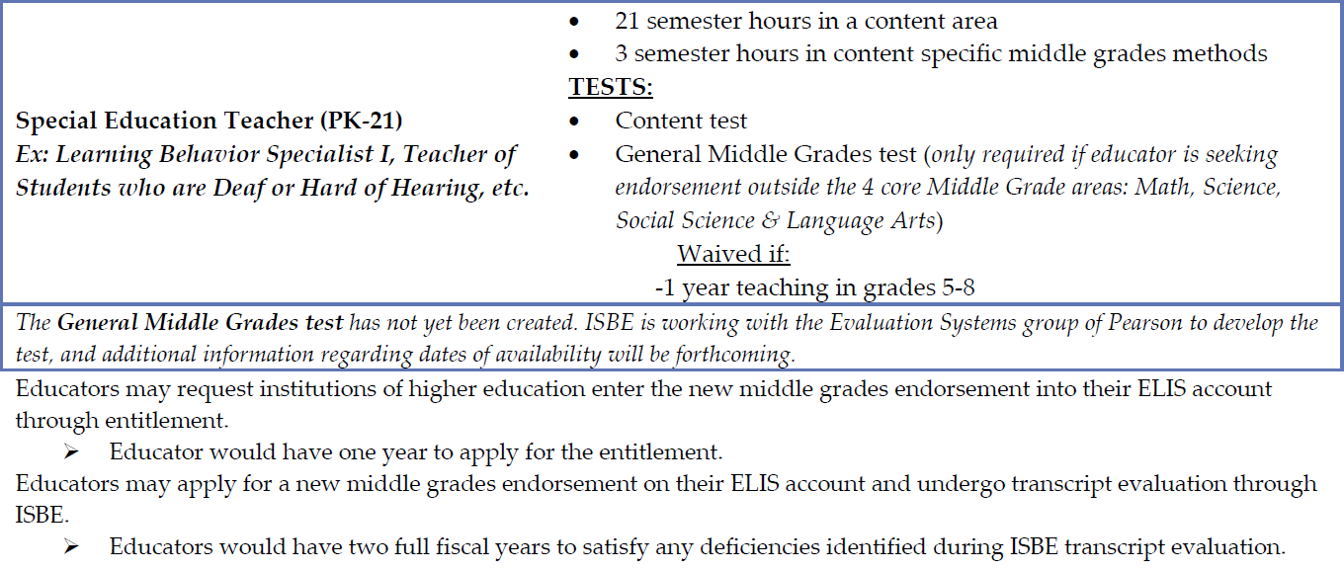
Requirements for educators seeking subsequent Middle Grades (5-8) endorsements on or after February 1, 2018

Slide 27
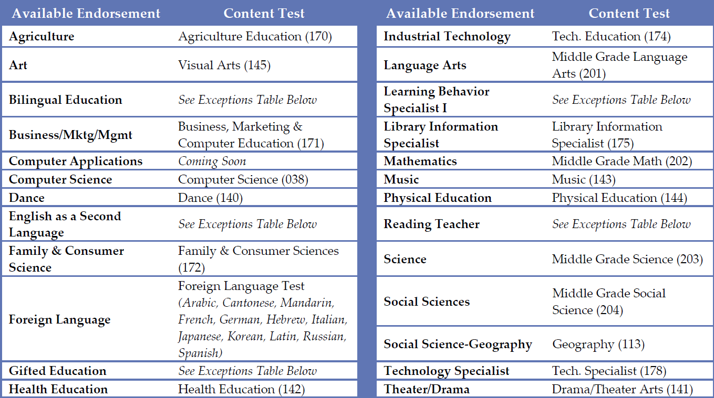
Available Middle Grades (5-8) endorsements on or after February 1, 2018, including corresponding content test
Middle School endorsements educators currently hold will not change!

Slide 28
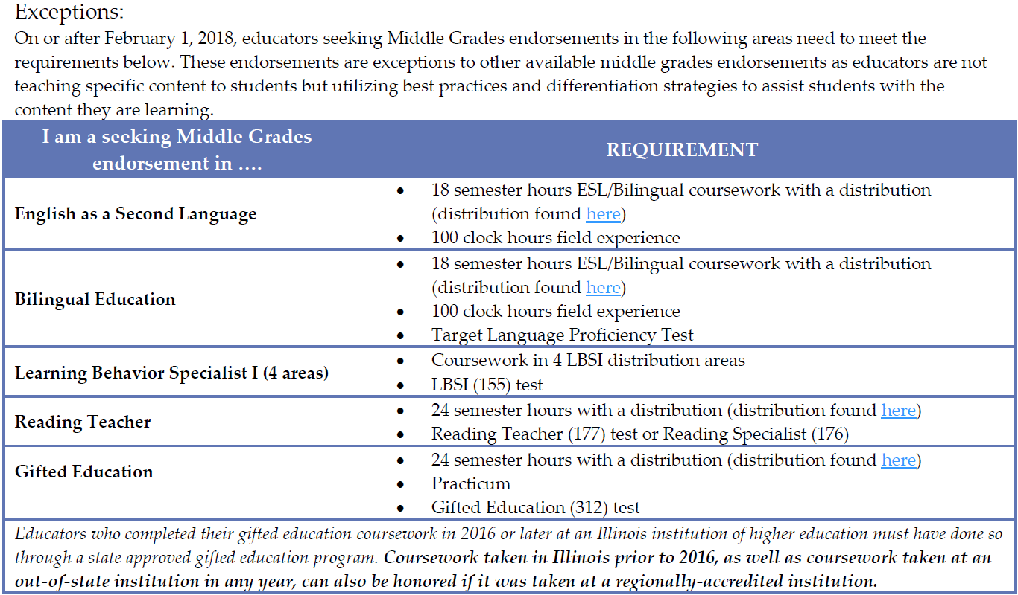
Available Middle Grades (5-8) endorsements on or after February 1, 2018, including corresponding content test

Slide 29
Supplemental Material
Where can I find supplemental material regarding middle grades endorsements in Illinois?
The Educator Licensure division at ISBE maintains a comprehensive document that outlines all requirements for educators seeking endorsements before and on or after February 1, 2018. The document provides a thorough overview of every content area available for middle grades endorsements and the specific requirements for each.
The Illinois licensure, endorsement, and approval requirements document can be found here: http://isbe.net/licensure/requirements/endsmt_struct.pdf
The Future of Illinois Middle Grades Resource Guide can be found here: http://isbe.net/licensure/pdf/higher-ed/future-of-illinois-middle-grades.pdf

Slide 30
ISBE Contacts
Center for Teaching and Learning
Emily Fox, Division Administrator efox@isbe.net
Tina Dimmitt-Salinas, Division Supervisor cdimmitt@isbe.net
Amy Cosgriff acosgrif@isbe.net
Bess Johnson lojohnso@isbe.net
Seth Mernaugh smernaug@isbe.net

Slide 31
QUESTIONS

Slide 32
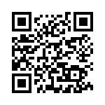
We value your feedback!
https://www.surveymonkey.com/r/isbemiddlegrades

