Slide 1
Improving Teacher Preparation Policy and Program
Building a High-Quality Teacher Workforce in Illinois

Slide 2
Overview:
Background on the grant and recommendation writing process
Overview of the current Illinois landscape
Shortages
Homogenous workforce
Poor perceptions of the profession
Leaky pipeline
Illinois Vision for Teacher Preparation
Guiding Principles
Recommendations
Recruitment
Training
Pathways
Rural Innovation
School and District Level Levers
Questions and Discussion

Slide 3
NGA Grant and formation of report
The Governor’s Office was awarded a small grant and technical assistance to pull together a strategy to address educator workforce problems in Illinois
The Governor’s Office then convened a small, but diverse, group of stakeholders to create recommendations for the state on how to improve teacher preparation. The group was made up of members representation the following types of organizations:
State Agencies
Colleges of Education, both public and private
Education Think-Tanks
Teacher Leader Non-Profit Groups
Regional Offices of Education
The members of this group met multiple times between November 2016-June 2017 as well as multiple smaller working group meetings. Each member of the group spent approximately 30 hours in meetings for this work. With 15 members sitting on the group, that makes for a total of 480 hours.

Slide 4
Overview of the Current Illinois Landscape: Shortages
Illinois faces a shifting educator workforce marketplace, with increasing teacher retirements, low retention rates, and a potentially growing teacher shortage.
Decreasing enrollment and completion in EPPs signal the threat of a growing shortage area - from 2000 – 2015 enrollment dropped 39%

Slide 5
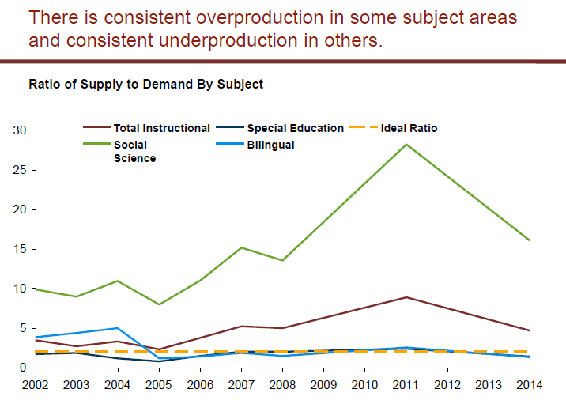
Overview of the Current Illinois Landscape: Shortages
Areas that face consistent undersupply:
Special Education
Bilingual
High School Math and Science
Regional Shortages – Rural and Small Schools

Slide 6
Overview of the Current Illinois Landscape: Shortages
However, while we know that shortages exist in certain subject and regional areas, data across the state is inconsistent.
ISBE reported in 2016 that there were 1,000 vacant teaching positions
IARSS Survey (2016) reported 60% of districts have difficulty hiring “high-quality candidates”
The Bellwether Analysis of 2014 ISBE Supply and Demand data found that the overall number of teachers outweigh the demand, but that these teachers are unevenly distributed across subject areas
One of the primary challenges faced by the state is the availability of consistent, reliable data. Without this, making targeted and effective change is difficult

Slide 7
Overview of Current Illinois Landscape: Homogenous Teacher Workforce

Slide 8
Overview of the Current Landscape: Poor Perception of the Teaching Profession
A poll conducted by Third Way of high-achieving college students found that:
Half of the students surveyed believe that teaching has gotten less prestigious in the last few years
Only 35% described teachers as “smart”
Education was seen as the top profession that “average” people choose
The OECD Teacher and Learning International Survey (TALIS) found that only 34% of U.S. teacher felt that teaching is valued by U.S. Society
If Illinois wants to build up a high-quality teacher workforce, these perceptions must change

Slide 9
Overview of the Current Illinois Landscape: A Leaky Pipeline
Illinois is losing potential teachers at every point of the pipeline.
Therefore for meaningful reform to take place, we must look systematically at the entire pipeline, not just adopt a single approach

Slide 10
Illinois Vision for Teacher Preparation
All children, especially those who need the most, deserve equitable access to highly effective teachers and leaders throughout their education. To achieve this vision, educator preparation programs must prepare a diverse group of high potential candidates across the state to be effective teachers. Upon entering the profession, teachers should have access to effective professional development opportunities that will lead to later leadership roles.
A well-prepared workforce is only possible with a streamlined, connected education system. Educator preparation programs, districts, and the state must collaborate and use data-driven decision making to steer recruitment, placement, and long-term planning strategies aligned with current and future workforce needs.

Slide 11
Guiding Principles
A commitment to equitable and adequate funding
A commitment to serving the needs of our 500+ rural districts
A commitment to the belief that the best policies are made collaboratively with the engagement of a variety of stakeholders
A commitment to align existing efforts across the state to reduce duplication of efforts and to break down the silos that have been created

Slide 12
Recommendations: Recruiting Diverse, High-Quality Teaching Candidates
Promote Early Positive Exposure to the Teaching Profession
ISBE Guide on how to become a teacher
Leverage PWR Act to highlight education as one of the pathways high school students can pursue
Leverage a student ambassador recruitment model
Pilot a Rural Teacher Corps Program
Revise Alternative Certification Rules to Increase Access Across the State

Slide 13
Recommendations: Training Teachers for Success in the Classroom
Development of an Annual, Effective Supply and Demand Report
Promote EPP and District Partnership
Convening of Deans of Education, leaders of Alternative certification, district leadership and hiring manager to share best practices on creating strong district partnership
Provide consultants/technical assistance to support the creation and maintenance of these partnership
Teacher Residency Pilot
Competency Based Student Teaching Framework

Slide 14
Recommendations: Creating Career Pathways for Teachers
Building teacher leadership and principal leadership pathways
Create differentiated pathways for teacher leaders
Leverage type 75 certificate
Increase the number of districts with strategic compensation programs
Collaborate with local teacher unions to explore alternatives to the single salary system that allow teachers to be rewarded for advancing their skills level and/or taking on teacher leader roles

Slide 15
Recommendation: Rural Education Innovation
Elevate the voice of the Governor’s Rural Affairs Council – Education Working Group to better address rural education needs throughout the state
Due to low capacity and resources, rural schools often have the fewest advocates
However, the have many pressing needs and make up over half our states districts

Slide 16
A focus on Educator Preparation Program levers: Student Ambassador Recruitment Model
Potential Responsibilities:
Identifying top students and organizations on campus throughout the year to target recruitment for the education major, such as:
tutoring and mentoring organizations
social justice classes and organizations
science and math classes
cultural organizations
Scheduling presentations and giving information sessions to classes and student organizations
Having offices hours to provide near-peer mentoring to potential majors
Marketing, publicity, and social media campaigns for the major

Slide 17
A focus on Educator Preparation Program levers: District-EPP Partnership
Initiation Stage
understand their talent pipeline and discuss these needs with teacher preparation programs
set the initial vision and goals together with a focus on relationship building
Implementation Stage
jointly select and train mentor teachers and strategically place candidates
ensure that district needs drive shifts in teacher preparation programs’ pipelines, structures, and systems
align on rubrics and key expectations for program graduates
commit to sharing and looking at data together to drive action
ensure coursework matches clinical experience and district language
communicate and meet frequently
spend more time in schools together
Continuous Improvement Stage
be open to change, and regularly step back to honestly discuss progress and challenges

Slide 18
Questions?

