Slide 1
Illinois Longitudinal Data System (ILDS)
Eric Lichtenberger – Illinois Board of Higher Education
Stephanie Bernoteit- Illinois Board of Higher Education

Slide 2
What is the Illinois Longitudinal Data System?
Builds from extensive existing efforts within and across agencies
June 30, 2013: Seven State of Illinois agencies and the Office of the Governor (IBHE, ICCB, DCEO, IDES, IDHS, ISAC, ISBE) enter into an intergovernmental agreement for ILDS
Establishes a cost-effective distributed LDS model that avoids duplication and ensures sustainability

Slide 3
Illinois Higher Education Information System
IBHE’s component of the ILDS
Through the ILDS ACT, we have the statutory authority to collect student-unit records from all MAP eligible schools, as well as schools that confer graduate or professional degrees (N=130)
Enrollment collection (three times a year)
Degrees collection (annual)

Slide 4
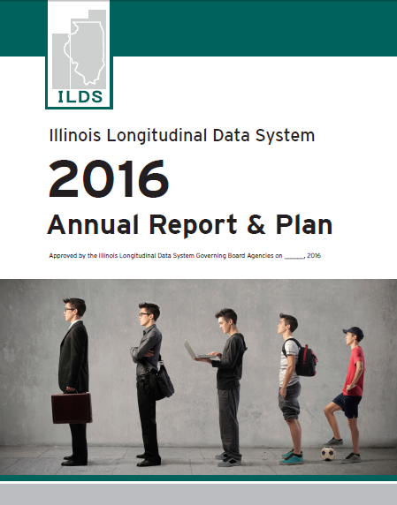
Active ILDS Governing Board Since 2013
Quarterly meetings with interagency leadership
Annual plans to establish priorities for action
Delegation to agency staff to carry out priorities
illinoislds.org

Slide 5
Statewide Longitudinal Data System Grant Program
Since 2009, ILDS-related activities have benefitted from over $20 M in funding through the federal SLDS grant program
Illinois recently received an additional $7 M through this competitive program
Focus for new grant:
Using data to better understand fiscal equity within education systems and return on investment
Delivering data for instructional support

Slide 6
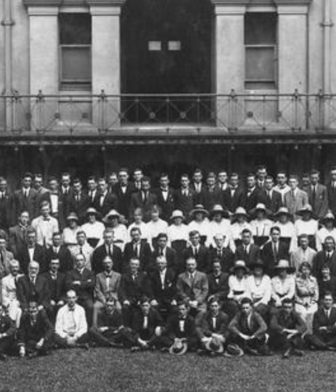
Privacy Protection
ILDS must fully comply with all state and federal law
Only aggregate analysis and reporting – never used to track an individual’s progress
Highest technological and process safeguards

Slide 7
ILDS-related Privacy Protection Laws
Federal
Family Educational Rights and Privacy Act
Privacy Act of 1974
Health Insurance Portability and Accountability Act of 1996 (HIPAA)
The Social Security Act
Gramm-Leach-Bliley Act
Higher Education Act of 1965
State
Illinois School Students Records Act
Illinois Public Aid Code
Illinois Unemployment Insurance Act
Identity Protection Act
Data Processing Confidentiality Act
P-20 Longitudinal Education Data Systems Act

Slide 8
ILDS is not this!!!

Slide 9
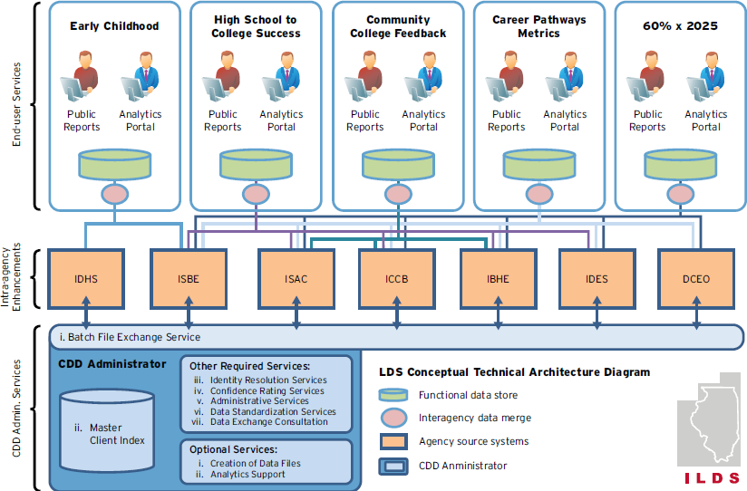
ILDS Conceptual Technical Architecture

Slide 10
Reporting Remedial Education Data
https://illinoisreportcard.com/

Slide 12
Agency-Specific Requirements
Some participating agencies impose their own additional requirements
Examples
ICCB: Institutional Review
IDES: Public Entity Sponsorship
Various: Internal Control Questionnaire
Education Systems Center staff consults on and facilitates these processes
Source: https://www.illinois.gov/about/PublishingImages/seal.gif

Slide 13
Master Client Index ID
All of the ILDS agencies periodically submit their demographic data to the Common Demographic Dataset Administrator (NIU)
After each submission the NIU creates a unique ID for each individual and provides that back to the agencies.
Agencies can then use the master client index ID to match their respective data sets together, without having to exchange sensitive information.
Reduces risk
Creates efficiencies in terms of matching and in processing data sharing agreements

Slide 14
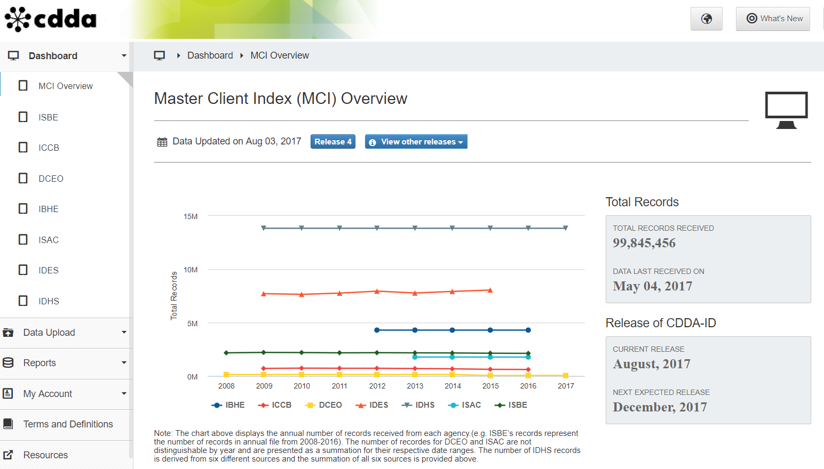

Slide 15
Gateways Credentials Project
Joint project: IBHE, INCCRRA, ICCB, OECD.
Focuses on the overlap between Gateways Credentials attainment and:
Certificate and degree completion
Enrollment patterns in college
College majors (enrollment and degrees)
Source: https://www.bls.gov/ooh/images/1641.jpg

Slide 16
Illinois Consumer Protection
United States Court of Appeals for the Seventh Circuit (8/29/17)
Illinois Bible Colleges Association, et al. v. Lindsay K. H. Anderson, Chair of the Illinois Board of Higher Education
“The statues in this case conform to the strictures of the Free Exercise Clause. First, they are neutral: They do not target religion or religious institutions…Further, certification of schools is based on the State’s review of the secular criteria that focuses on the schools’ faculty, facilities, and courses…Likewise, the laws are rationally related to a valid government purpose, namely protecting students and employers from relying on degrees with no true academic value, and protecting legitimate institutions of higher education by safeguarding the value of their degrees.”

Slide 17
Points of Connection
Public Act 99-0674 Illinois Postsecondary and Workforce Readiness Act (PWR Act) - signed by the Governor on 7/29/16
Postsecondary and Career Expectations (PaCE)
Pilot of competency-based high school graduation requirements
Scaling of 12th grade transitional courses
College and career pathway endorsements on high school diplomas
P-20 Council
State ESSA plan
Governor’s Cabinet on Children and Youth
Apprenticeships and work-based learning with connections to the PWR Act
Early childhood workforce development
Notes:
Connections to Schools and Colleges of Education:
Education pathway – career exploration, recruitment, early college, and other planning strategies beginning in middle and high school
Possibilities for embedding credentials within degree programs
Work-based learning – implications of apprenticeship discussions for student teaching/teacher residency models, etc.
Importance of partnership with employers
Equity and diversity issues throughout
Know who at your institutions is attending or following these meetings

Slide 18
Points of Connection
Data and Information
Career outcomes tool
ISBE PEP project
Workforce supply and demand
Counting credential completion within and on top of degree programs

Slide 20
Thank you! Questions….
Eric Lichtenberger Lichtenberger@ibhe.org
Stephanie Bernoteit Bernoteit@ibhe.org

